Slide 1
React Ecommerce
Squad Berners Lee

Slide 2


















Programming Languages & Technologies

Slide 3
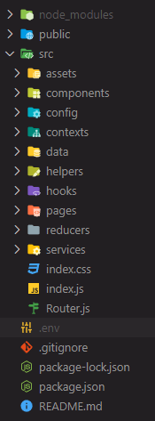
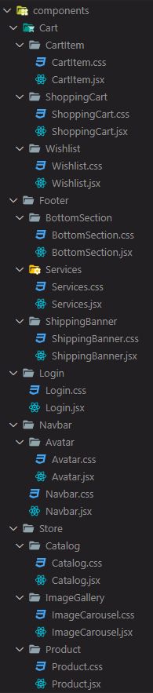
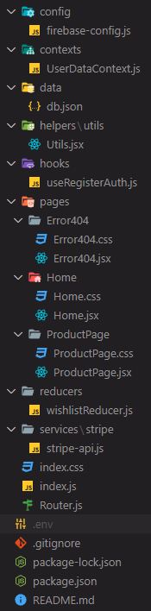
The Folder Structure

Slide 4
Hooks
Other hooks we used:
useReducer
We use "useReducer" instead of "useState" at wishlistCart
useLocation
useNavigate
useParams
useState
We used useEffect at:
ProductPage fetching the data from the API and filtering it by the productID.
Home we use it here to Convert a JavaScript object into a string with JSON.stringify() In this case is the useState to modify the initial state.
Catalog here we make fetching data from the API and setting it to the state.
Wishlist in this case, we use useEffect to update the state of the component.
ShoppingCart is called when the component is mounted and when the shoppingCart is updated.
useEffect
UserDataContext We used useContext Hook to Store user data in LocalStorage.
useContext
We used Custom Hook to handle the Login process. (useRegisterAuth)
Custom Hook

Slide 5
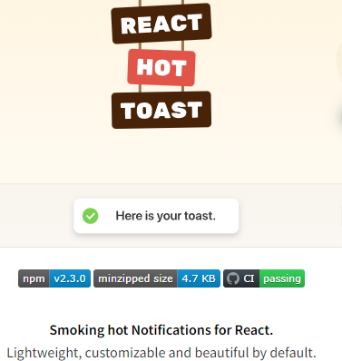
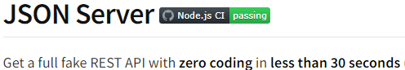
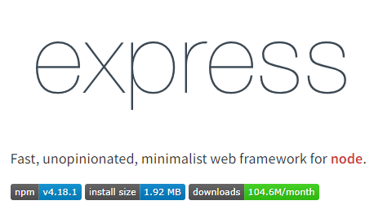
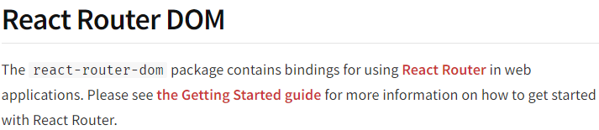
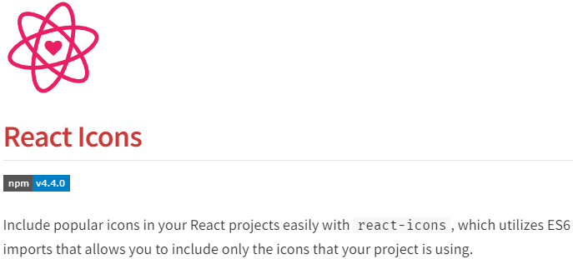
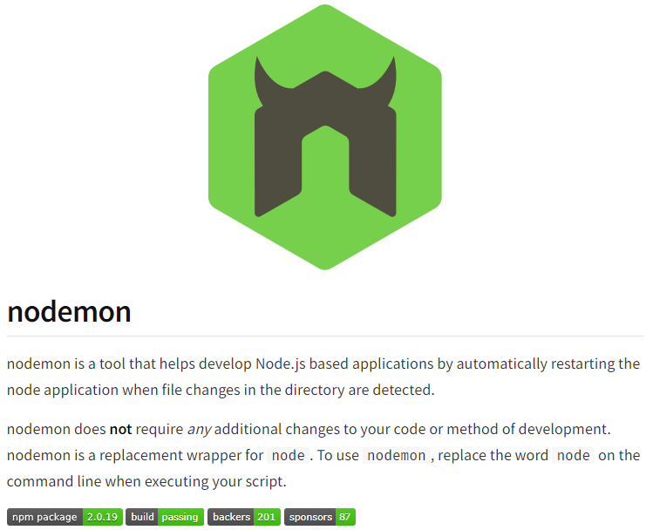
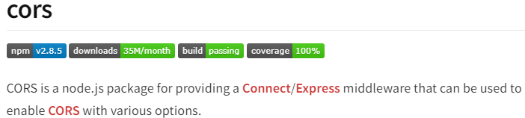
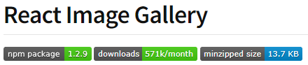
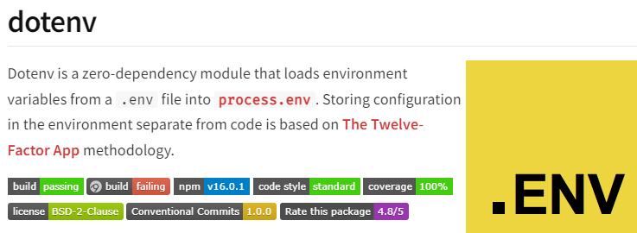
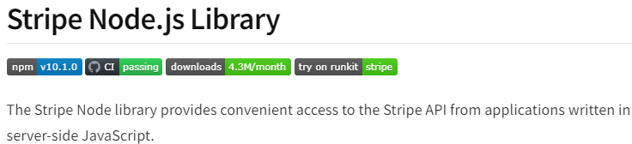
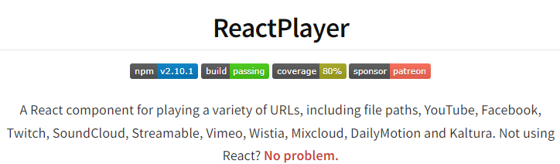
Npm Packages we used:

Slide 6
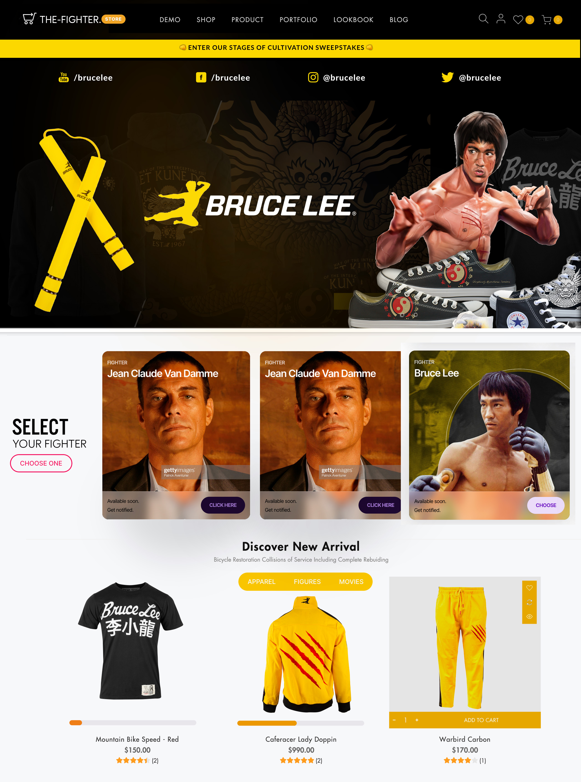
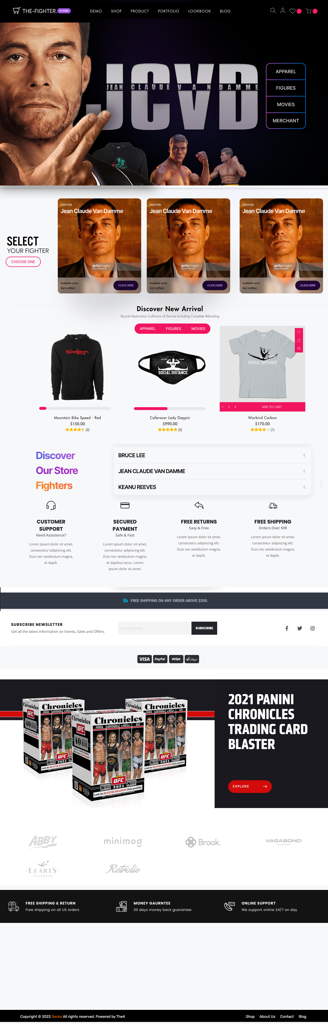


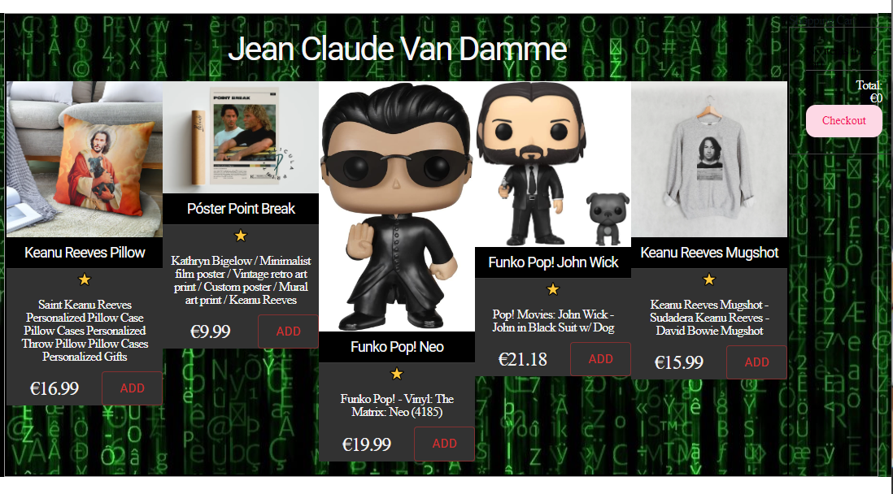
Design Examples

Slide 7

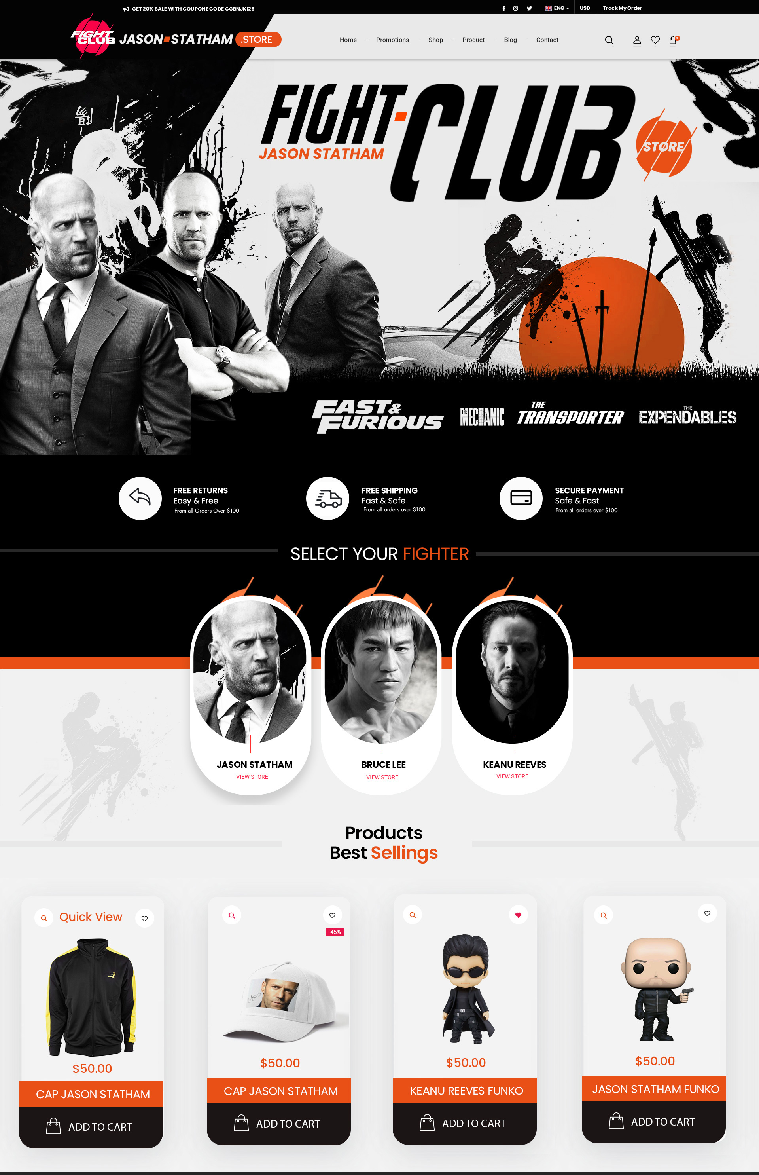
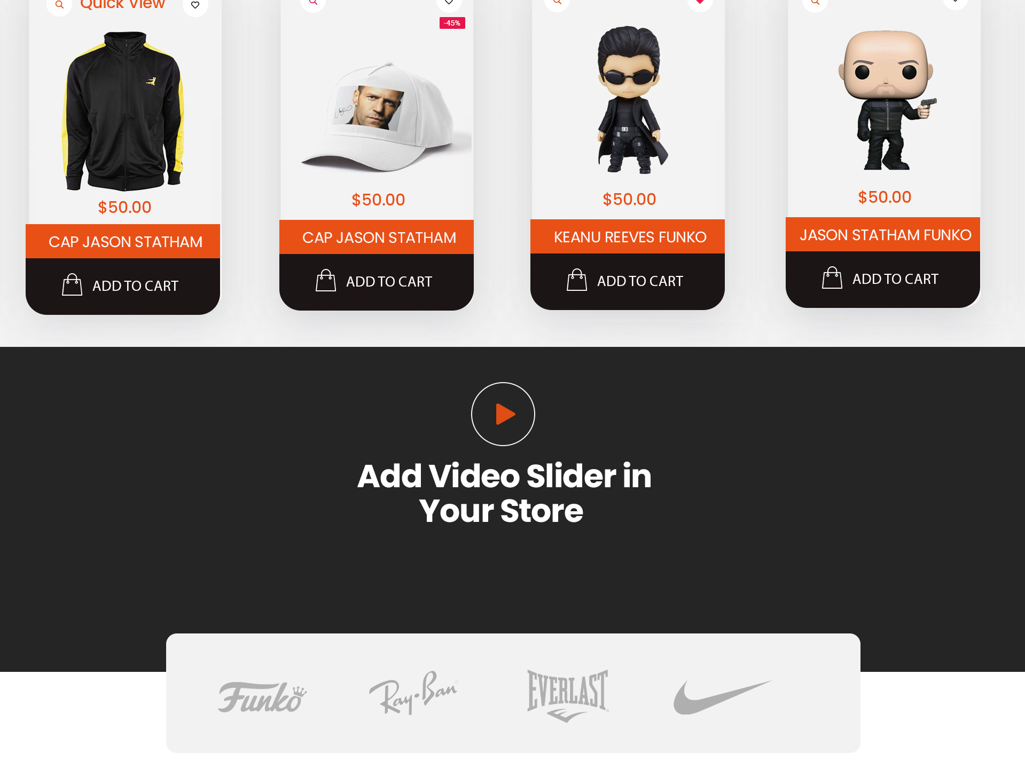
The importance of E-commerce in “Modern Business”
Staying on top of e-commerce trends if not an option – it’s necessity.
+info: https://www.forbes.com/sites/forbestechcouncil/2022/03/14/e-commerce-trends-2022-what-the-future-holds/?sh=3a697c4c58da

Slide 8
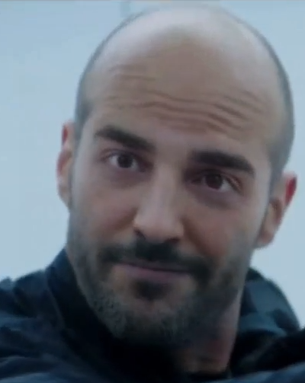
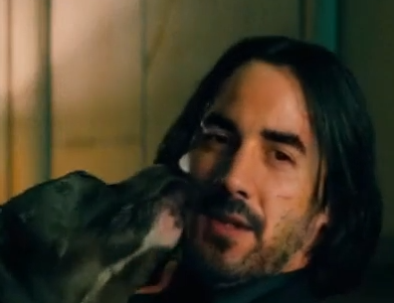
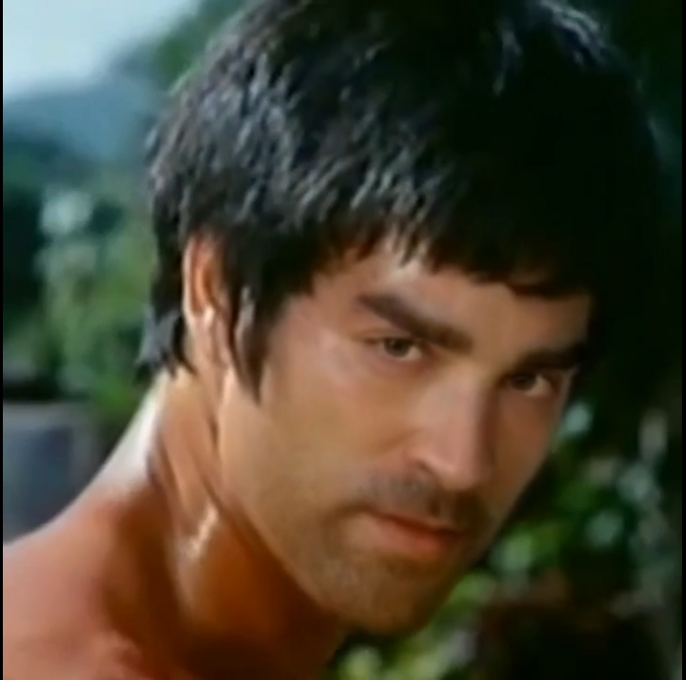
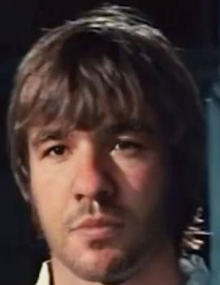
Squad Berners Lee
Ricardo Vieira
Marcel Barreiro
-”No existo”.
-”Joder, se me ha olvidado comer”.
Alejandro Avila
Javier Fernández
-”Si vale más de dos euros, es muy caro”.
-”Para puntualizar…”.

Slide 9
Special THANKS to Carlos Velilla for being great Programmer, Person and Friend. We will miss you!!.
https://youtu.be/fWoxv60cz00

